Slide 1
Away match
Home Team: averages 2.11 overplayed defenders per pass.
Average is for top 5 players evaluated on this metric.
By: Daniel Andrade
Email: daniel@mgma.io

Slide 2
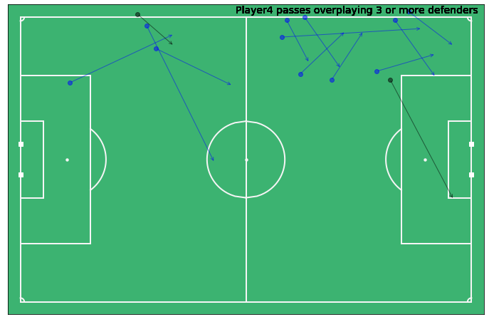
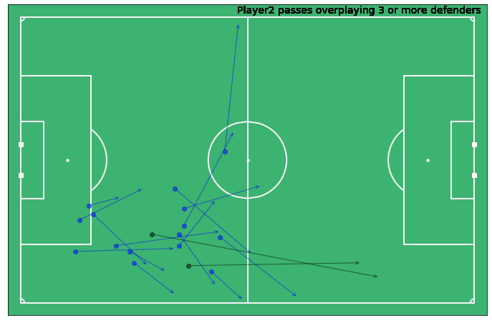
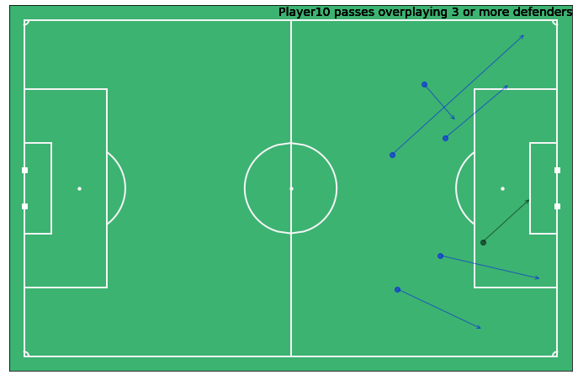
Passing threat closes down from the wings (main visual)
Approach: Passes that cut through our formation lines create chances that we need to avoid during our match game visit.
Black Arrows represent risky passes (less than 0.5 prob)
Player 4 black arrow lead to second goal of the game.

Slide 3
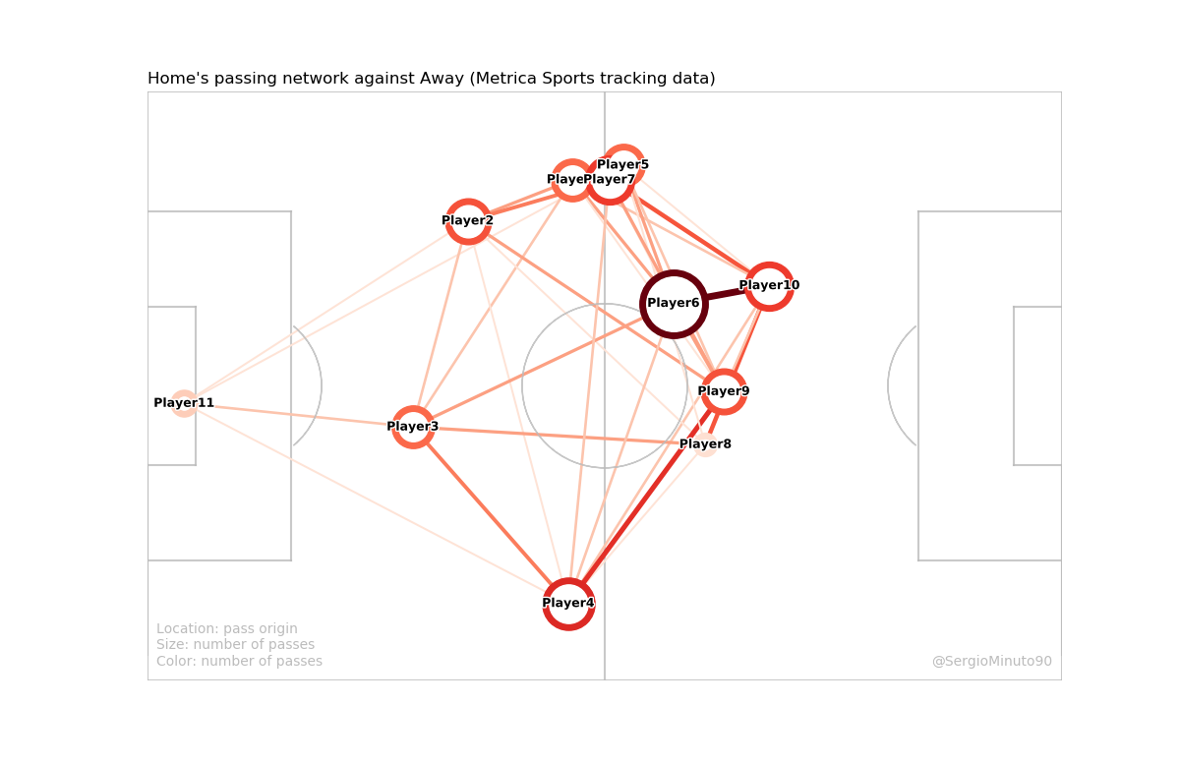
What to expect?
Player 2 and Player 10 tend to feed the wings.
We can expect Player 4 to play safe (no risky passes) on his wing as we can also see has a strong volume of passes towards the last third.
Executed the Passing Network code from Sergio’s contribution to #FoT

Slide 4
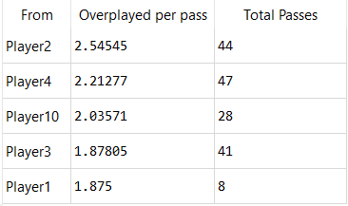
Top 5 Home Team players
overplaying defenders
The goal of this analysis is to lead our midfielders to a more efficient pressing. Player 2 seems to take some risky chances and has the highest average of overplayed defenders per pass. Reducing his average can be an indicator that we have found a strong formation to be more intense in our attack.
Credits : Metrica Sample_Game_1
Friends of Tracking Github repo (Passing Network and Metrica functions were executed)
Code Notebook: https://github.com/Mgmaplus/Resources/tree/master/Projects/2020Sounders

